Slide 1
₹
BANKING ANALYTICS PROJECT
Banking Customer & Risk Analytics
A plain-language walkthrough of customers, loans, transactions and branch performance
Prepared by Gayatri Kasbekar
gayatrikasbekar1311@gmail.com | github.com/Gayatrik04
Built with Python · MySQL · Power BI

Slide 2
OVERVIEW
What This Presentation Covers
No technical background needed — every number is explained in plain business terms.
1
The Problem
2
The Solution
Why banks need one clear, trustworthy view of their data
How raw records became one easy-to-use dashboard
3
The Dashboard
4
Key Numbers
A look at the four report pages built for the business
The headline figures every leader should know
5
What We Found
6
What To Do Next
Insights about customers, loans, risk and branches
Practical recommendations and the roadmap ahead
Banking Customer & Risk Analytics
2

Slide 3
THE PROBLEM
Data Was Everywhere — Answers Were Nowhere
Every day, a bank creates huge amounts of data — new accounts, loan repayments, card swipes, UPI transfers. But this data usually sits scattered across separate systems, making simple questions surprisingly hard to answer quickly.
🎯
The Goal
Which customers are most valuable — and which might leave?
Bring five separate banking datasets together into one clean, reliable source — and present it through a dashboard any manager can use, technical or not, to make faster, evidence-based decisions.
Which loans are most likely to default, and why?
Which branches and regions are performing best?
Are customers financially comfortable, or stretched thin?
This project informs decisions — it does not automate lending decisions.
Banking Customer & Risk Analytics
3

Slide 4
THE SOLUTION
From Raw Records to a Ready-to-Use Dashboard
Three simple stages turn scattered spreadsheets into business answers.
1
2
3
4
📄
🧹
🔎
📊
Raw Data
Clean & Organise
Analyse
Present
5 linked datasets:
75K customers · 85K accounts
30K loans · 500K transactions
100 branches
›
Python fixes missing data,
removes duplicates, and creates
business fields like income group
and risk category
›
MySQL answers 35+ real
business questions, from
top branches to default rates
by loan type
›
Power BI turns the results
into one interactive dashboard —
filter and explore with no
coding required
Banking Customer & Risk Analytics
4

Slide 5
KEY NUMBERS
The Bank, At a Glance
These are the headline figures every leader should know.
75,000
₹6bn
₹2.41bn
30,000
Total Customers
Total Transaction Value
Total Deposits
Total Loans
5.39%
500K
92.01%
₹4bn
Loan Default Rate
Total Transactions
Transaction Success Rate
Total Loan Amount
Banking Customer & Risk Analytics
5

Slide 6
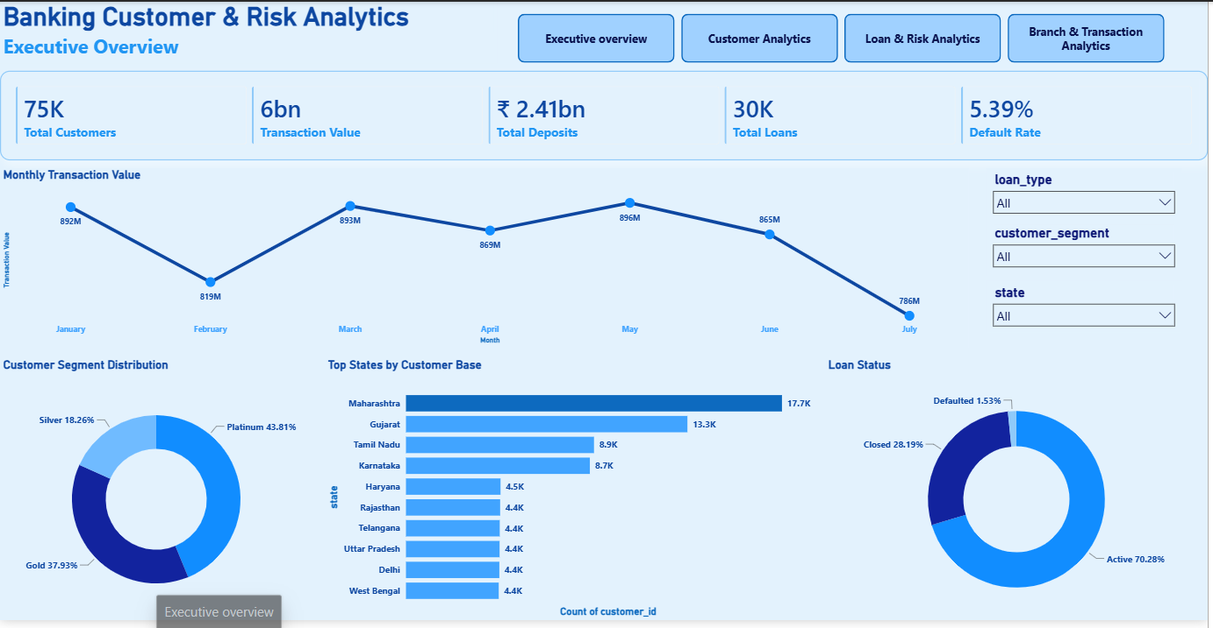
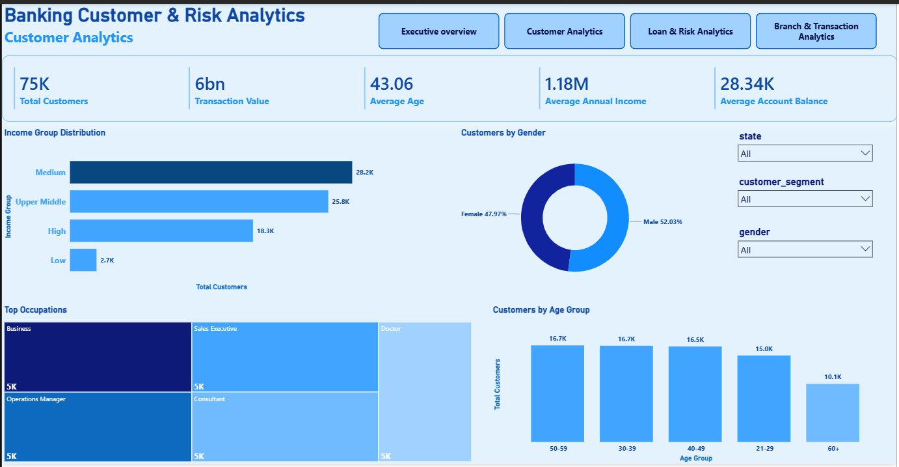
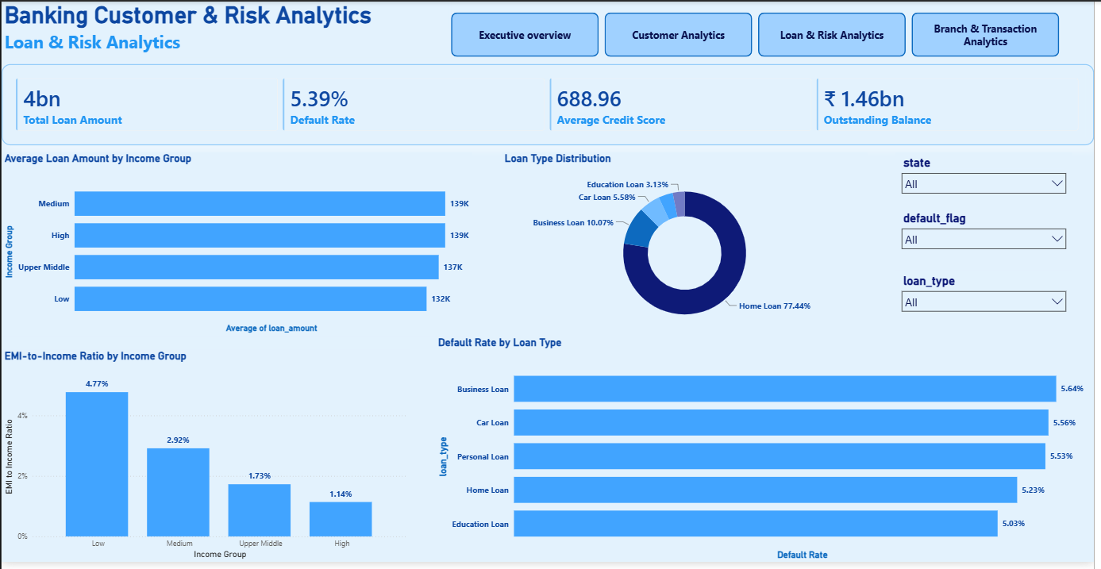
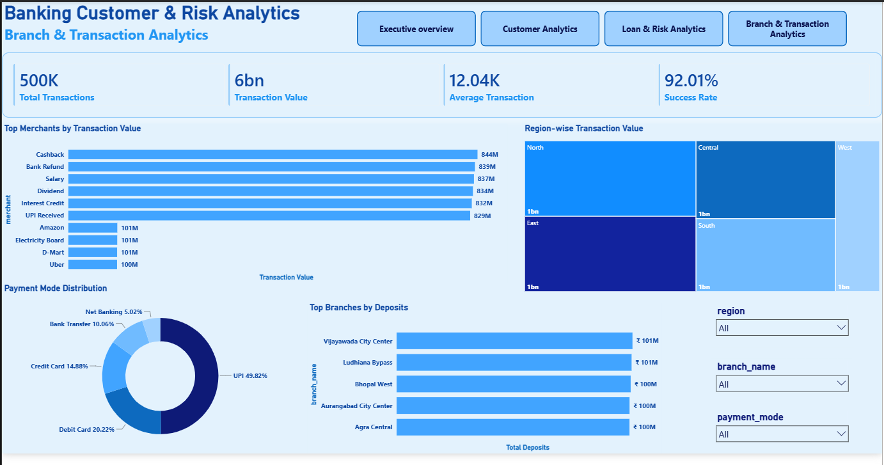
THE DASHBOARD
One Dashboard, Four Views — Built for Every Team
Executive Overview
Customer Analytics
Leadership snapshot
Marketing & relationship teams
Loan & Risk Analytics
Branch & Transaction
Credit & risk teams
Branch & payments teams
Banking Customer & Risk Analytics
6

Slide 7
WHAT WE FOUND · CUSTOMERS
Who Our Customers Are
⚖
Balanced Base
52% male, 48% female — a broadly even customer mix.
Customer Segment Mix
Platinum
43.8%
🎂
Middle-Aged Majority
Customers aged 30-59 make up roughly two-thirds of the base.
Gold
37.9%
🏆
Mostly Premium
Silver
18.3%
Platinum (43.8%) is the largest customer tier — a broadly loyal, affluent base.
📍
A Few Key States
Top States by Customer Base
Maharashtra, Gujarat, Tamil Nadu & Karnataka hold ~half of all customers.
• Maharashtra — 17.7K
• Gujarat — 13.3K
• Tamil Nadu — 8.9K
• Karnataka — 8.7K
Banking Customer & Risk Analytics
7

Slide 8
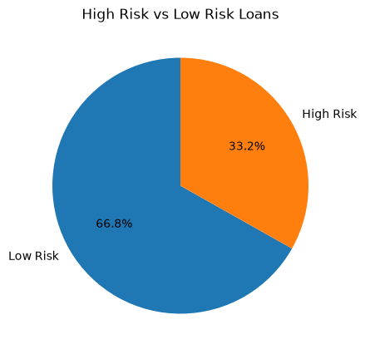
WHAT WE FOUND · LOANS & RISK
How Healthy Is the Loan Book?
Loan Risk Split
Credit Score Is a Strong Predictor
What Do People Borrow For?
Home Loan
77.4%
21.68%
Business Loan
10.1%
default rate for "Poor" credit-score customers
Car Loan
5.6%
5.39%
Education Loan
3.1%
2 in 3 loans are Low Risk
overall bank-wide default rate — roughly 4x lower
EMI Burden by Income
(66.8% low risk vs 33.2% high risk)
Low income: 4.77% of monthly income → High income: 1.14%
Banking Customer & Risk Analytics
8

Slide 9
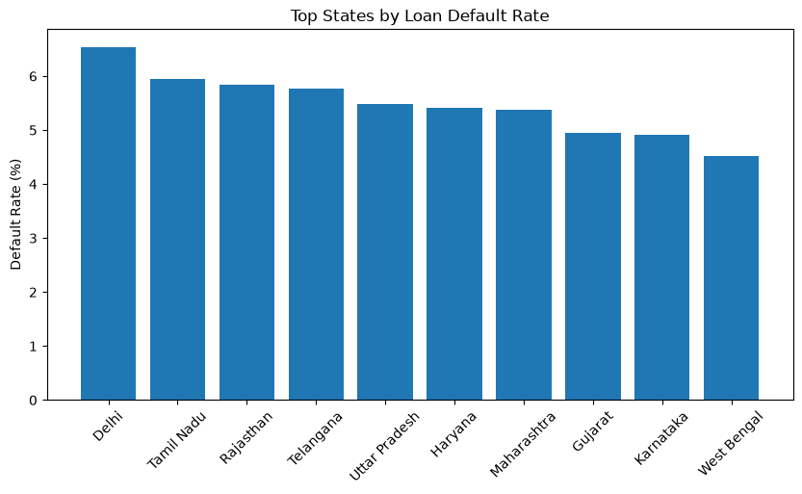
WHAT WE FOUND · LOANS & RISK
Where Loan Risk Is Highest
Default rate by state — states are not equally risky.
Highest Risk
Delhi — 6.5%
Tamil Nadu — 5.9%
Rajasthan — 5.8%
Lowest Risk
West Bengal — 4.5%
Karnataka — 4.9%
Gujarat — 4.95%
Useful for targeting collections support and regional lending policy.
Banking Customer & Risk Analytics
9

Slide 10
WHAT WE FOUND · TRANSACTIONS & BRANCHES
How Money Moves Through the Bank
49.8%
92.01%
₹100M+
₹0.75bn
of transactions are via UPI — the leading payment method
transaction success rate — about 1 in 12 currently fail
held by each of the top 5 branches by deposits
West region transaction value — the lowest of all regions
Regional Transaction Value
₹1455M
₹1450M
₹1223M
₹1144M
₹746M
North
East
Central
South
West
Banking Customer & Risk Analytics
10

Slide 11
WHAT TO DO NEXT
Recommendations for the Business
🛡
📞
⚙
Tighten lending for "Poor" scores
Support stretched borrowers early
Fix the 8% failed transactions
Add stricter checks or risk-based pricing — this group defaults 4x the average.
Reach out to lower-income customers before repayment strain turns into default.
Even small gains in success rate protect meaningful value at this transaction volume.
🏅
🌍
🎯
Learn from top-deposit branches
Invest in the West region
Use segments for targeted offers
Study what Vijayawada, Ludhiana, Bhopal, Aurangabad & Agra do well, then replicate it.
Transaction value there trails every other region — a clear growth opportunity.
Design retention offers by Platinum/Gold/Silver tier, and grow Silver into Gold.
Banking Customer & Risk Analytics
11

Slide 12
🏦
Thank You
Questions and feedback are welcome.
Gayatri Kasbekar
gayatrikasbekar1311@gmail.com | github.com/Gayatrik04
Full technical documentation available in the project report and README.

